Slide 1
Edge Computing vs Cloud Computing

Slide 2
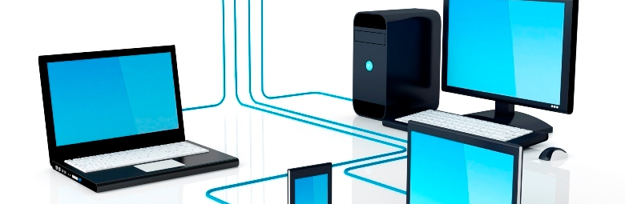

Cloud Computing
Cloud computing is the on-demand availability of computer system resources, especially data storage (cloud storage) and computing power, without direct active management by the user.

Slide 3
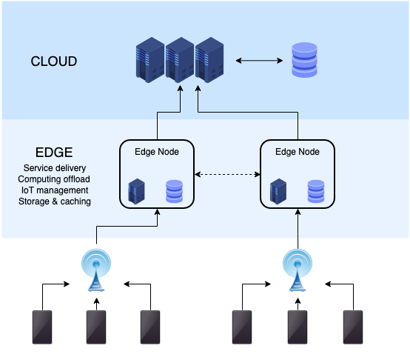
Edge Computing
Edge computing brings data storage and compute power closer to the device or data source where it’s most needed. Information is not processed on the cloud; instead, the cloud comes to you – the data is distributed on decentralized data centers (nodes).

Slide 4
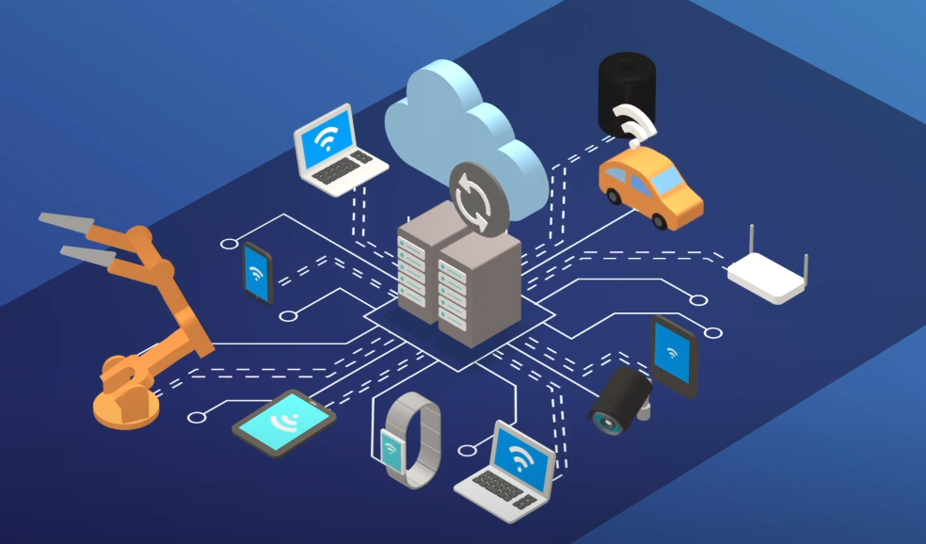
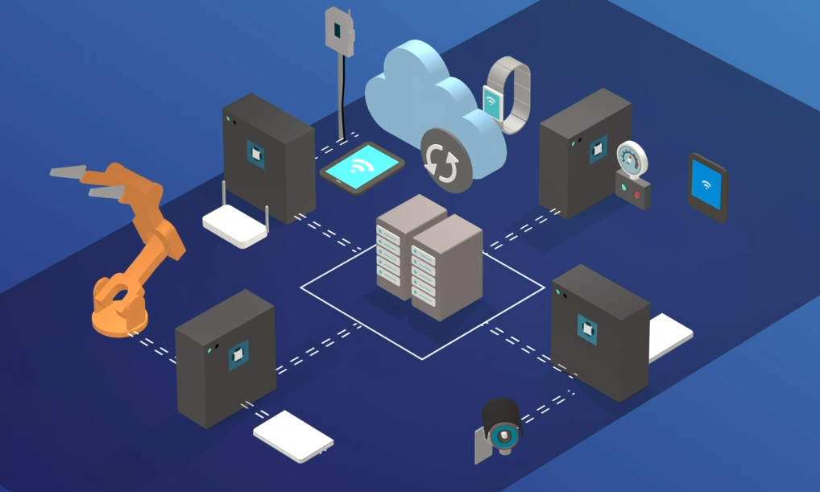
Differences
Cloud computing Edge Computing

Slide 5
Advantages
Advantages of Edge Computing:
Files can be kept locally
Gives control over sensitive information
Advantages of Cloud Computing:
No need to invest in securing local networks
Allows storage of large amounts of data with no limitations
Easy to deploy on multiple devices

Slide 6




Benefits
There are lots of key benefits to Edge Computing:
Reduced latency
Security
Scalability
Versatility

Slide 7

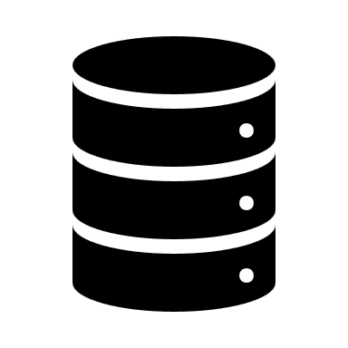


Challenges
Despite all these advantages, cloud computing is not near to being perfect:
Power supply
Space
Maintenance
Safety

Slide 8
Edge Computing Uses
Edge computing can be very useful in a variety of industries:
Self-driving vehicles
Healthcare software
Manufacturing
Every “Smart” product

Slide 9

Cloud or Edge?

Slide 10
REFERENCES
https://en.wikipedia.org/wiki/Edge_computing
https://en.wikipedia.org/wiki/Cloud_computing
https://phoenixnap.com/blog/edge-computing-vs-cloud-computing
https://www.youtube.com/watch?v=3hScMLH7B4o&ab_channel=IDGTECHtalk What is edge computing?

